Slide 1
Krish Dubey
Introduction to Flask & Setting Up the Environment
Overview
Python Installation
Virtual Environment Setup
Flask Installation

Slide 2

What is Flask?
A lightweight web framework for Python
Used for developing web applications quickly
Minimalistic and highly ﬂexible

Slide 3


Why Use Flask?
Ideal for small to medium projects
Scalable to handle large applications
Used by big companies like Netﬂix, LinkedIn, Uber

Slide 4

Use Cases of Flask
Rapid prototyping
Simple blogs and websites
Complex web applications

Slide 5
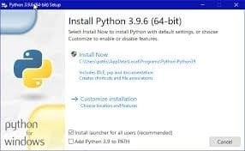
Installing Python
Visit python.org
Download the latest version
•Ensure 'Add Python to PATH' is checked during installation

Slide 6
Setting Up Virtual Environment
In terminal/command prompt: python -m venv env
Activate the environment:
Windows: .\env\Scripts\activate
Mac/Linux: . /env/bin/activate

Slide 7
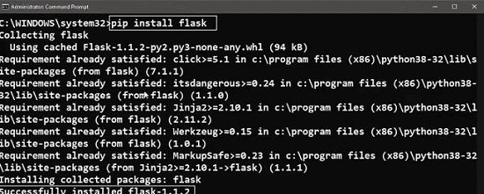
Installing Flask
In activated environment: pip install ﬂask
Verify installation: python -m ﬂask --version

Slide 8
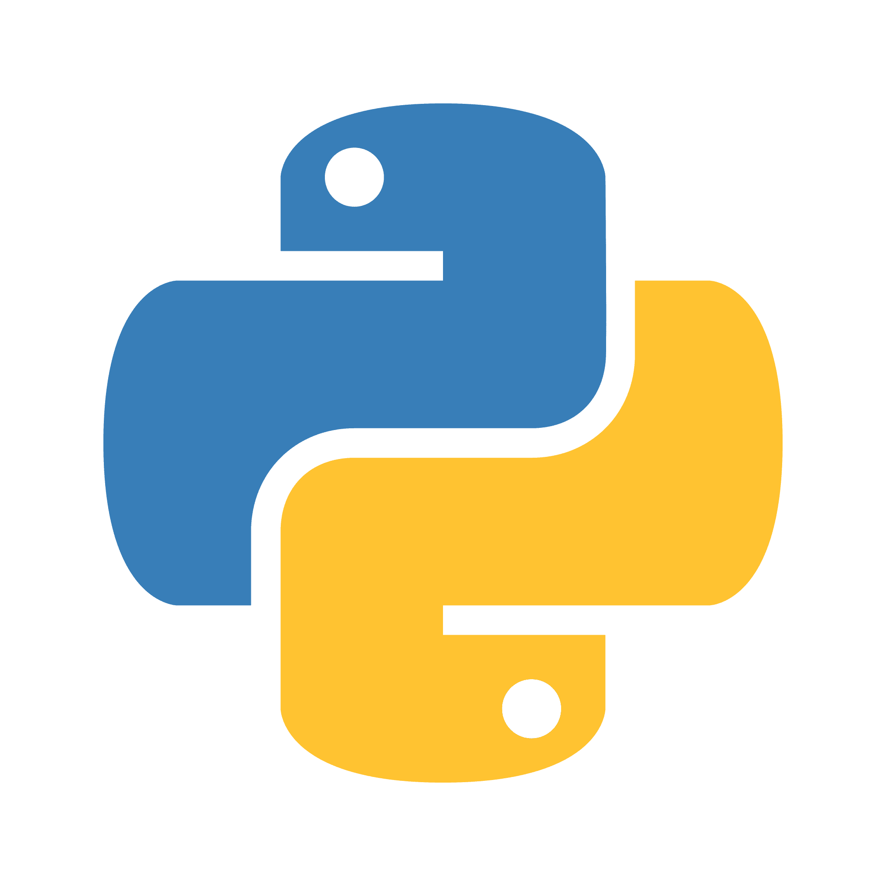
Summary
Flask: A versatile, minimalistic web framework
Set up Python and virtual environment for project isolation
Flask installation is straightforward with pip

Slide 9
What's Next?
Creating your ﬁrst Flask app
Understanding Flask's basic structure

Slide 10

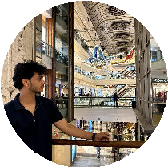



Thanks for Watching!
Like, Share, and Subscribe
Hit the bell icon for updates
@boogeyman0307 @dubeykrish @_krish_54

